Slide 1
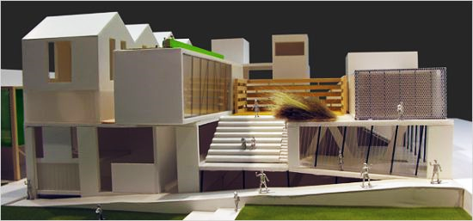
Yr8 Concept Housing Project
Cheesy Tag line:
Building the future,
now!
http://www.bbc.co.uk/education/clips/zc69wmn

Slide 2
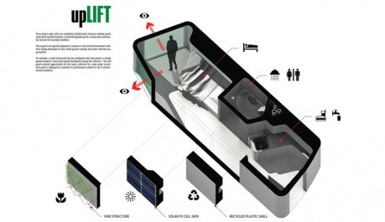
Brief
You have been asked to research, design and develop prototypes of modular housing that will be used for new towns and village being built over the country. The aim will be supporting families in modern , affordable, energy efficient homes

Slide 3
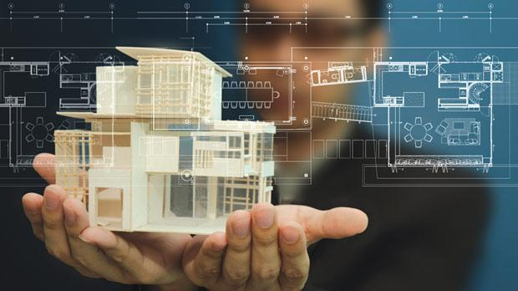
Specification
It must have several zones – Kitchen, living/communal room, Sleeping areas, Bathrooms
It must be practical for a range of groups – families, children, elderly
It must be constructed using SIP (Structured insulated panels)
It should be energy efficient
It should use modern technologies and materials
It should be made suing sustainable materials
It should be visually creative
It should be possible for the building to link together
It could incorporate renewable energy resources
It could have several floors

Slide 4
Tasks
1a - Research: Materials and Energy
1b - Company branding & logo development
2a - Concept designs – 2d Drawing & 3d Drawing (Profile, 2 point
perspective and isometric)
2b - Floor plans and side/section/layout drawings
3a - CAD training with Google Sketch up
3b - CAD Design developments (Google Sketch up)
4a – Modelling prototypes with card
4b - SIP Design – CAD/CAM using 2D design.
Final Presentation of Ideas and Judging of the winners
The final winning designs will be cut on the laser cutter

Slide 5
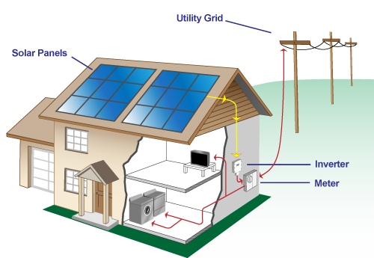
1a Research: Materials and Energy
What are Photo-voltaic cells?
http://www.energysavingtrust.org.uk/renewable-energy/electricity/solar-panels
Are they worth the initial cost? How long do they currently take to pay for themselves, Should they be used in your build and why?
What is a MHVR unit? How can it make homes more energy efficient?
How can Geothermal energy be used in your housing development?

Slide 6
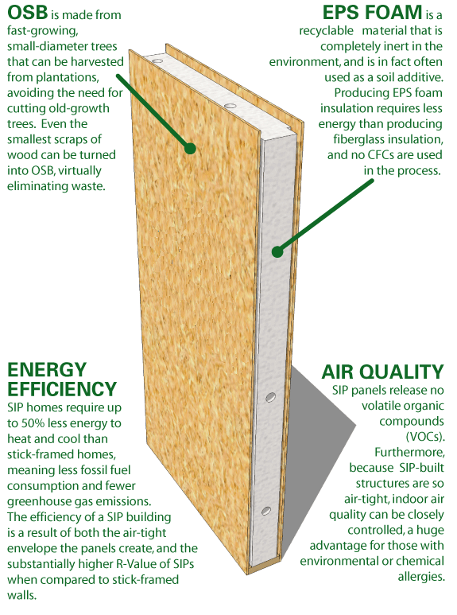
1a Research: Materials
What are Structural insulated panels (SIPS)? https://www.homebuilding.co.uk/sips-how-do-they-work/
Why are they a sustainable way of building houses?
How can you make a house energy efficient?
What other types of building materials are sustainable?
What materials have a low carbon footprint?
What are the advantages and disadvantage of using sustainable materials?

Slide 7
1b Company branding & logo development
LOGO
COMPANY NAME
On the inside page, Mind map 10 company name ideas.
Decide as a group on the best one
Each Draw an initial ideas for a logo
Decide on the best one
Add this to the front page

Slide 8
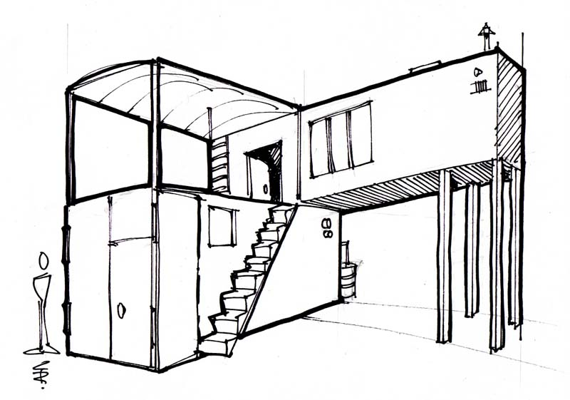
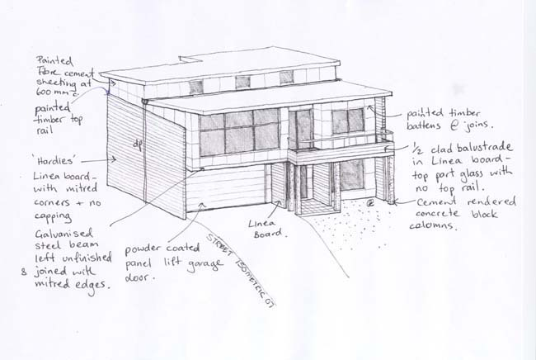
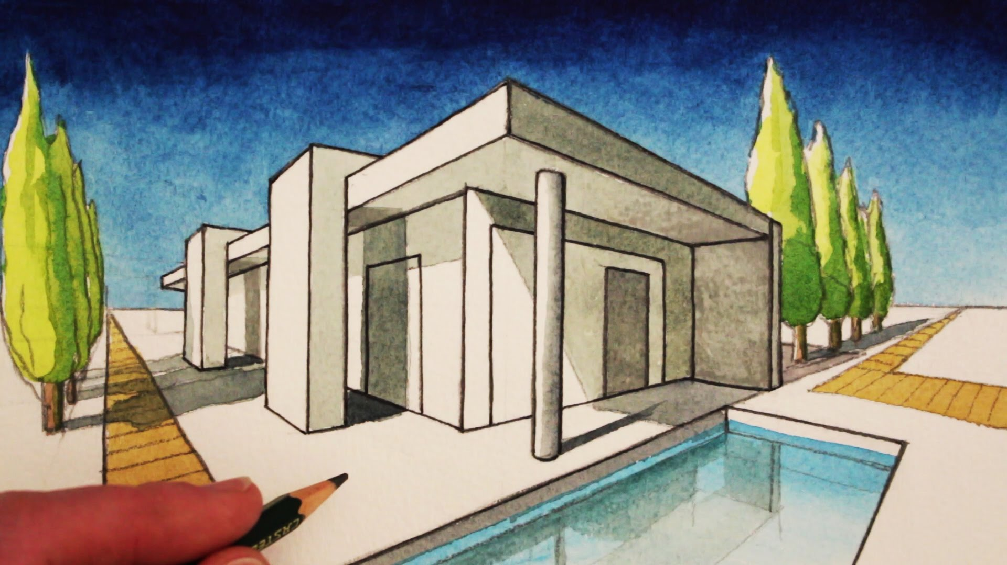
Concept designs – 2d Drawing & 3d Drawing
(Profile and section view
point perspective and isometric)

Slide 9
How to do 2 point perspective
Two Point Perspectiveo-point perspective.
what happens
when you place your cube above, below and on the horizon line!
1. Draw a line across the middle of your page - this will be your horizon
3. Draw one side of your cube - using projection lines to one vanishing point
2. Draw in two vanishing points
5. Draw two projection lines to the vanishings point for the base - draw in the outlines
6. Add thick and thin lines and rub out your unwanted construction lines.
4. Draw in the other side - once again using projection lines

Slide 11
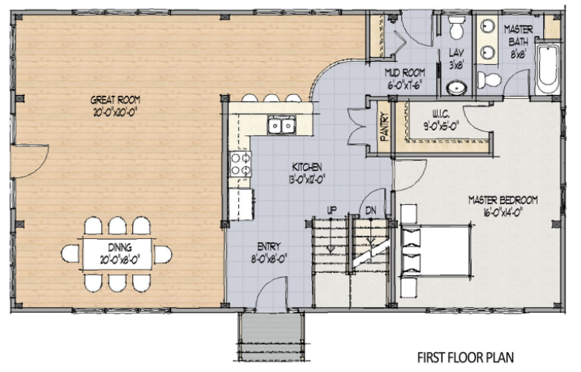
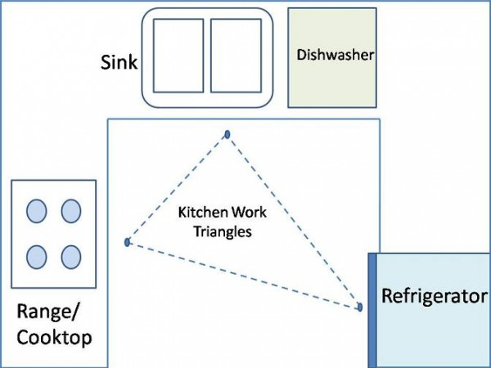
Extended task: Do Floor plans and layout drawings

Slide 12
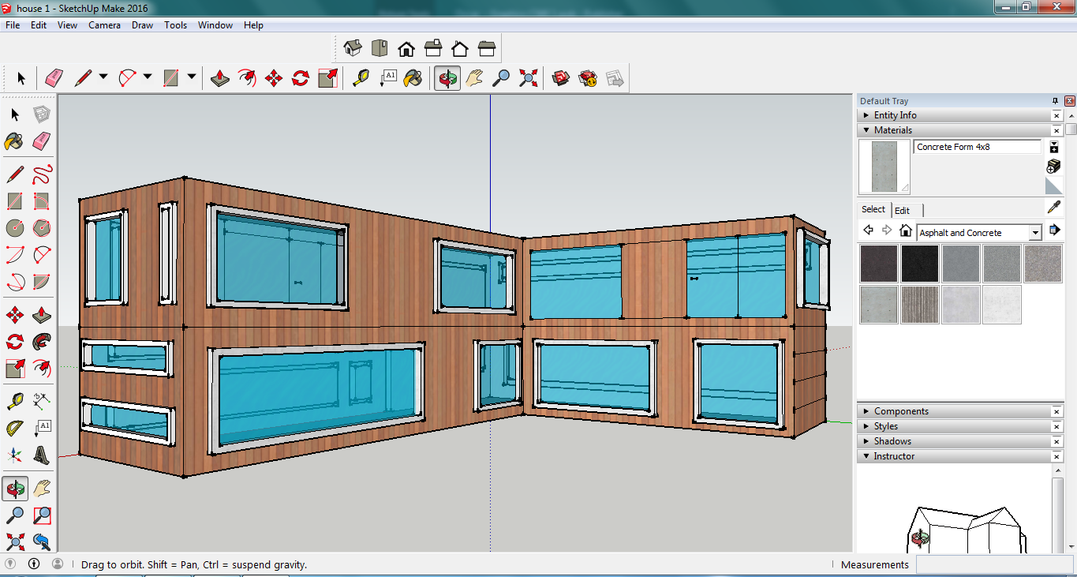
2c CAD Developments ( Google Sketch up)
Follow the tutorials: T:\DandT\Sketchup

Slide 13
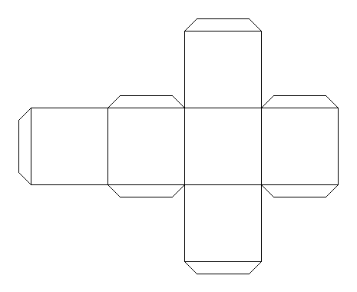
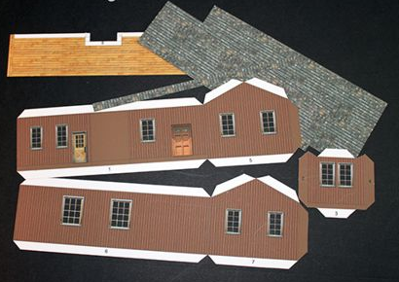
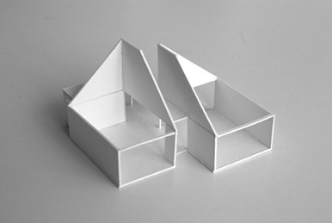
Modelling
You will need to make nets of parts of the house
The most simple net to think of is for a Dice
You will have tabs to hold it in place and score lines to fold ( score lines should be on the inside
Use Pencils, Rulers to mark out your panels
Use Stanley knives, Saftey Rules & cutting mat.
Be careful and cut away from yourself!
Add surface detail in pencil then black pen
Use Masking tape to Join, then glue gun (supervised!)

Slide 14
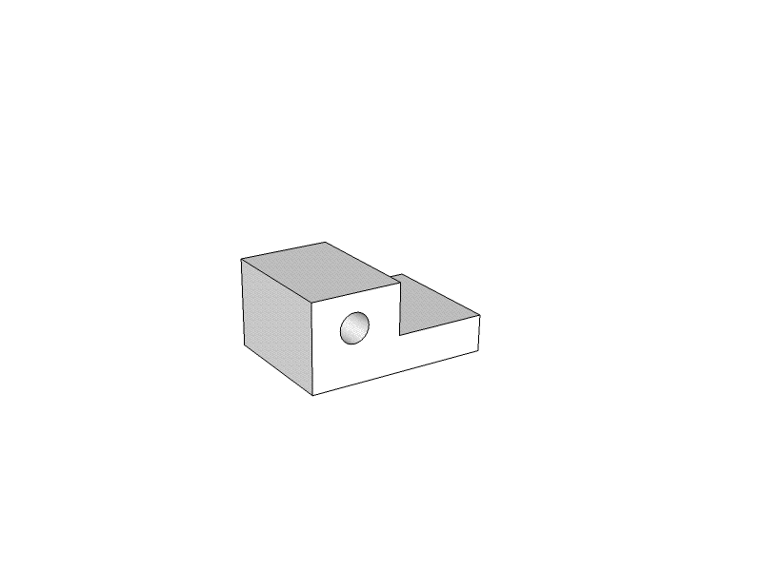
Final Orthographic Drawing

